Slide 1
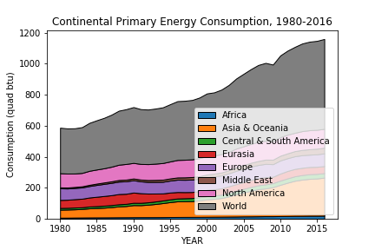
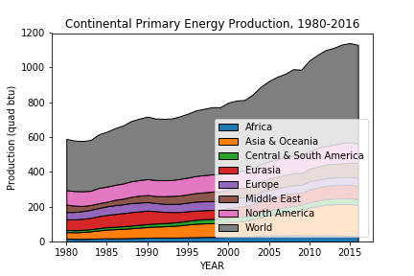
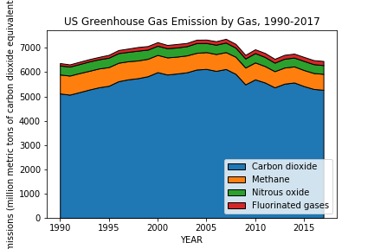
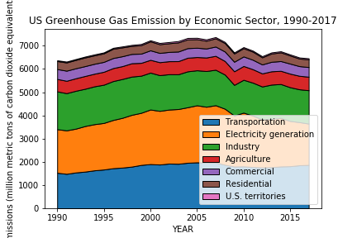
THE DATA – Plot
Quadrillion British
thermal unit
Emissions (million metric
tons of CO₂ equivalents)

Slide 2
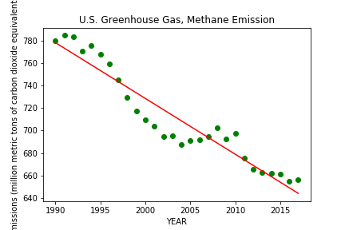
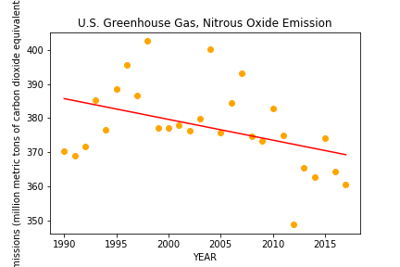
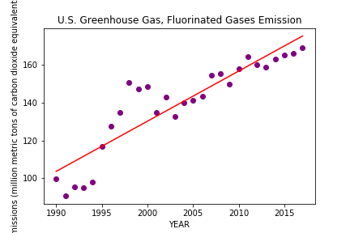
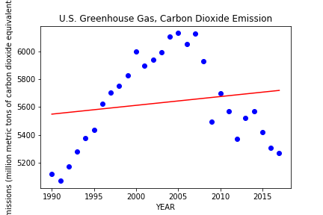
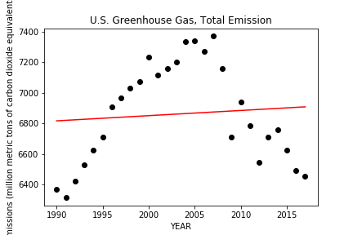
LINEAR REGRESSION Greenhouse Gases
16%
6%
2%
Emissions (million metric tons of CO₂ equivalents)
76%

Slide 3
ARIMA AutoRegressive Integrated Moving Average
Forecasts stationary time series.
Model incorporates (3 parts):
Auto-regressive (AR) - weighted sum of lagged values of the series.
p = order of the AR term = the number of lags of Y to be used as predictors.
Integrated (I) - difference of the time series.
d = the minimum number of differencing needed to make the series stationary.
Moving-average (MA) - weighted sum of lagged forecasted errors of the series.
q = order of the MA term = the number of lagged forecast errors that should go into the ARIMA Model.
Often noted as ARIMA( p, d, q )

Slide 4
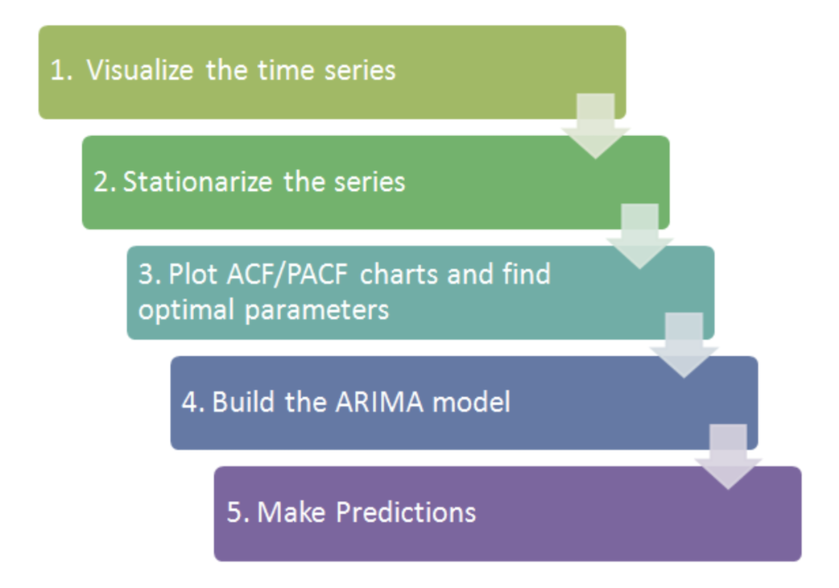
ARIMA AutoRegressive Integrated Moving Average

Slide 5
ARIMA – Stationarity
Stationarity is the property of exhibiting constant statistical properties (mean, variance, autocorrelation, etc.).
If the mean of a time-series increases over time, then it’s not stationary.
Types of Series (4):
Seasonality
Cyclicity
Residuals
Trend: A long-term increase or decrease in the data.
Method:
De-trending
Logging
Differencing – difference between current value and the previous value
1st-order - addresses linear trends
2nd-order - addresses quadratic trends

Slide 6
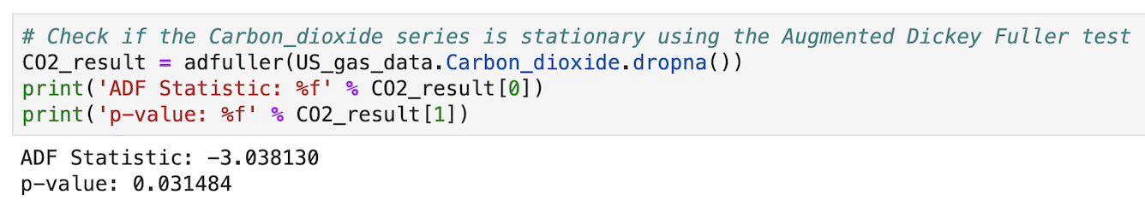
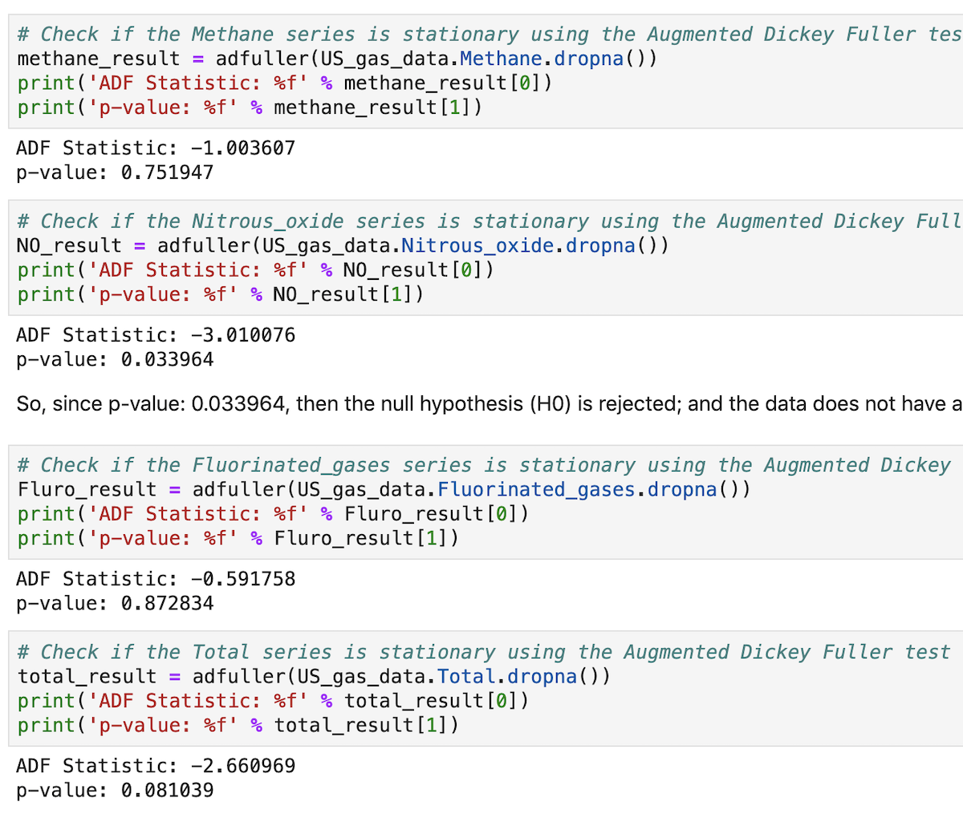
ARIMA – Stationarity Test
Augmented Dickey-Fuller Test & KPSS
If p<0.05,
then reject null hypothesis
Stationary!
Notes:
Augmented Dickey-Fuller Test
This test assesses whether or not a time-series is stationary. This test will give a result called a “test-statistic” with different levels (percentages) of confidence, if the time-series is stationary or not.
KPSS
The KPSS (Kwiatkowski-Phillips-Schmidt-Shin) test tests for the null hypothesis that the series is trend stationary. If the p-value of the test statistic is below the X% confidence threshold (0.05%), this means we can reject this hypothesis and that the series is not trend-stationary with X% confidence. A p-value higher than the threshold will lead us to accept this hypothesis and conclude that the series is trend-stationary.

Slide 7
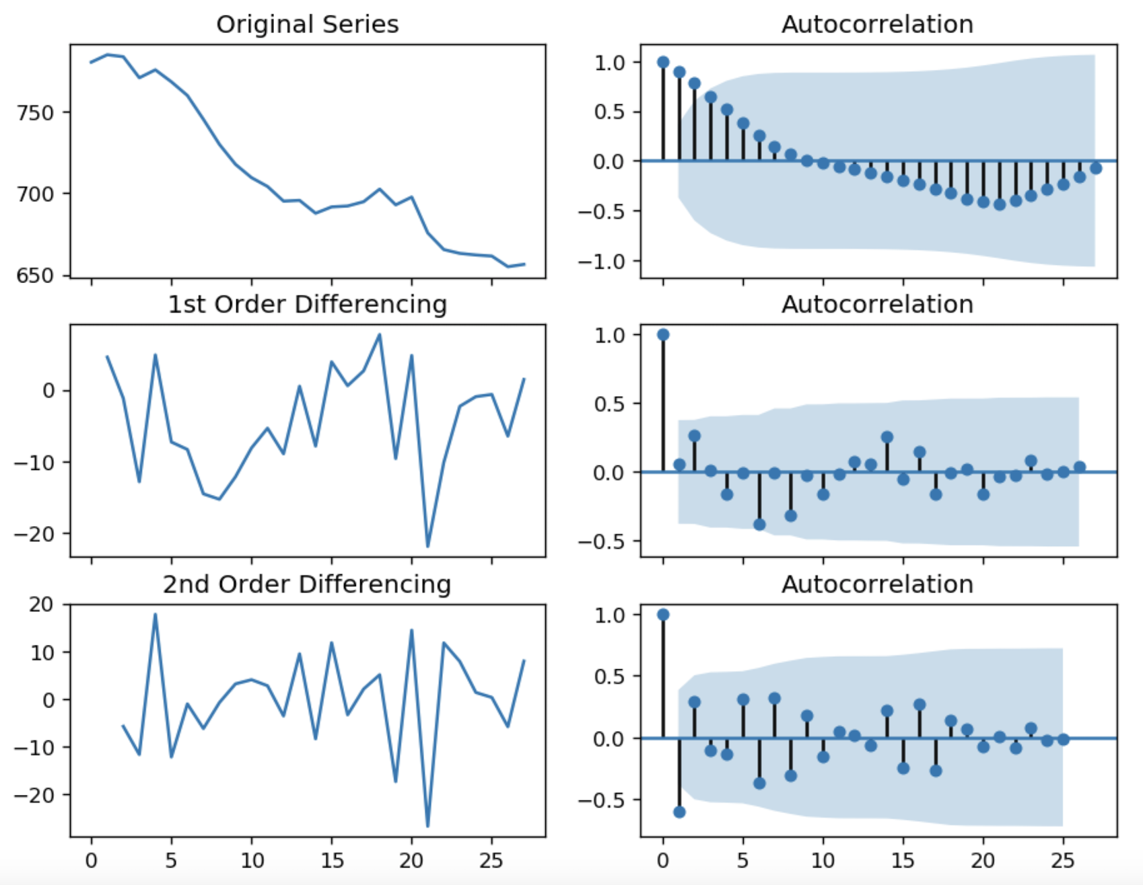
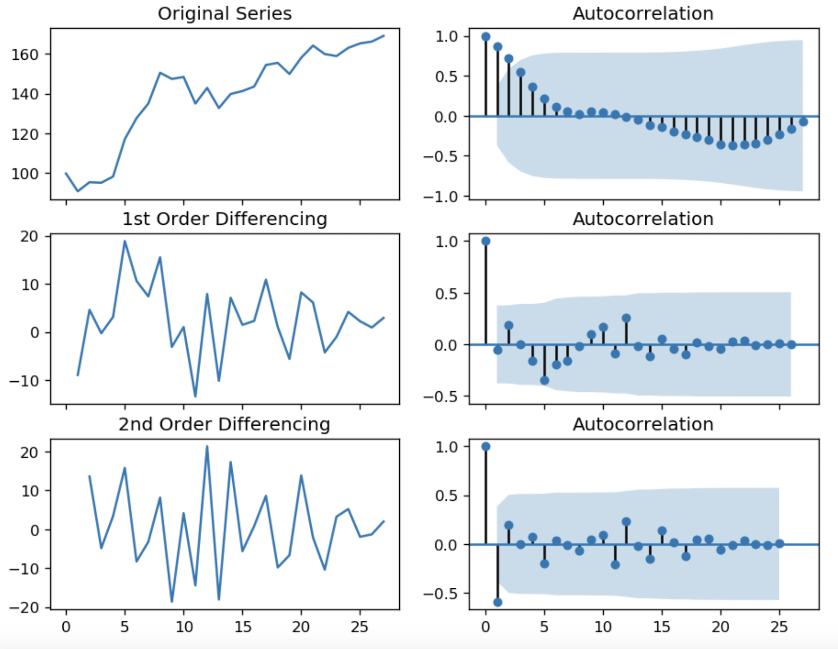
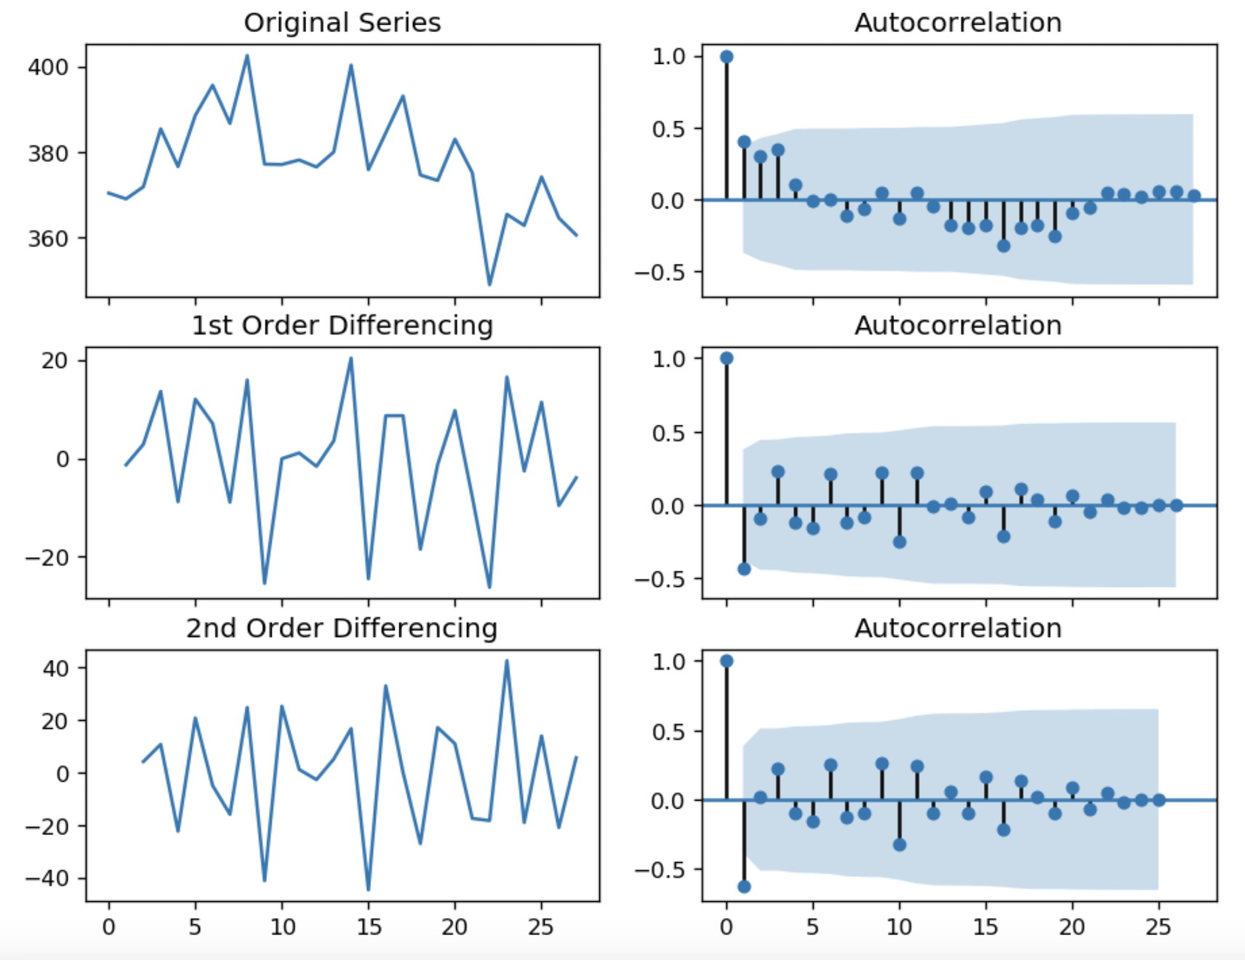


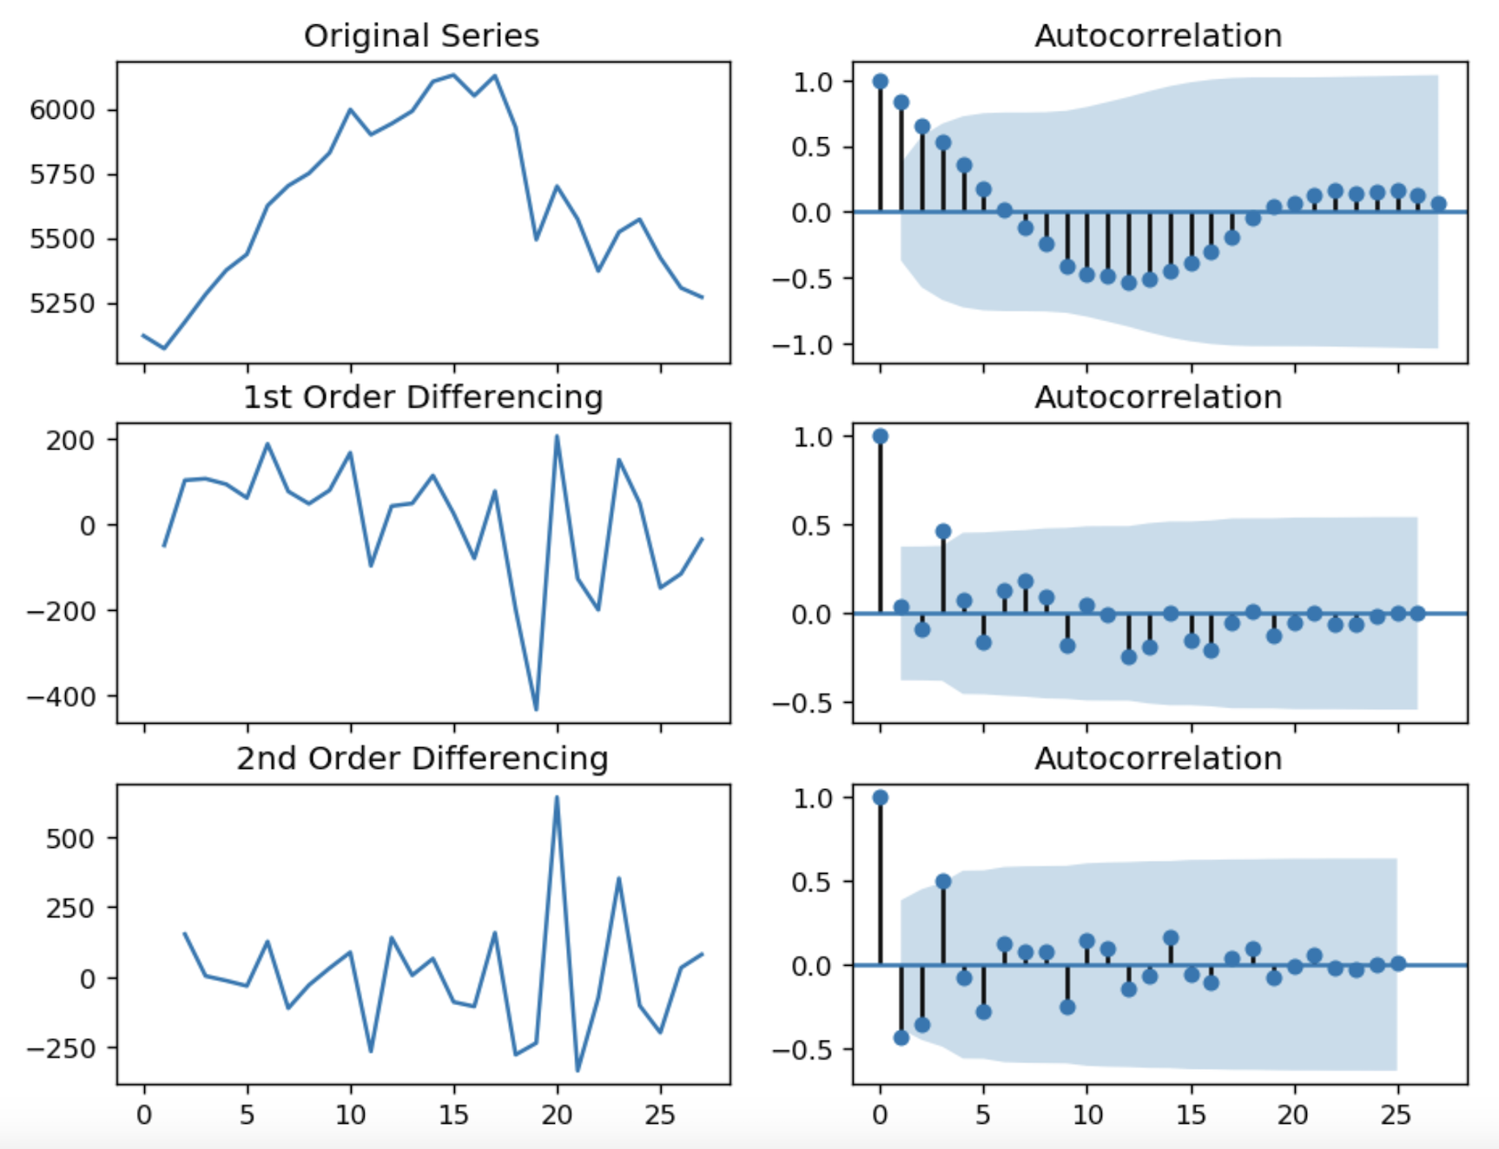
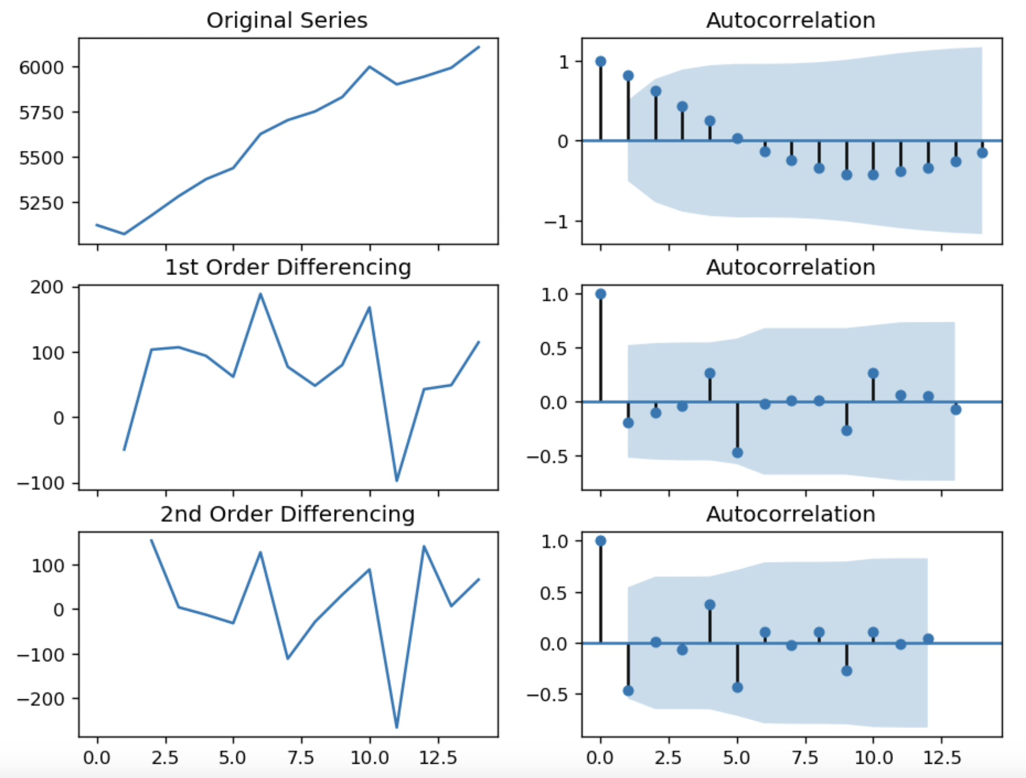
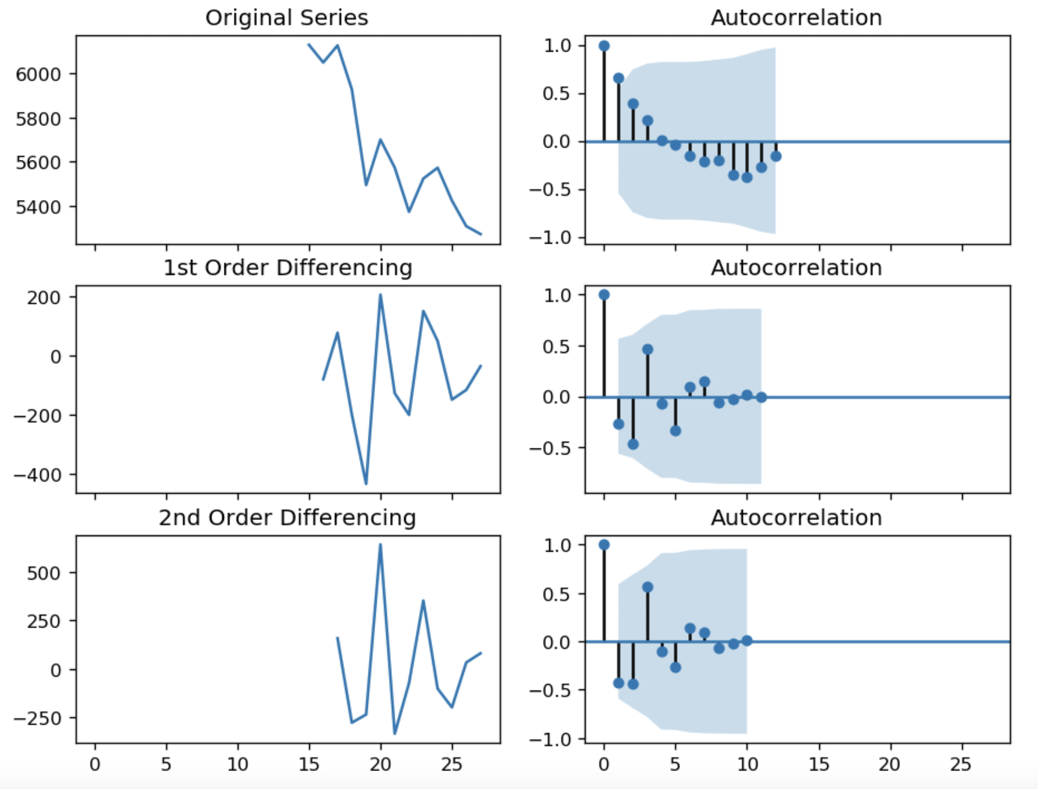
ARIMA – Stationarity & Autocorrelation (ACF)
Methane
Fluorinated Gases
Nitrous Oxide
Over differenced
CO₂
CO₂ Uptrend
CO₂ Downtrend
Over differenced
Notes:
Autocorrelation in time series forecasting refers to the correlation an observation has between itself and another observation in the time series.
What to look for? Fast decay! Slow decay means it’s not stationary, as seen in the first autocorrelation plot. A fast decay is shown with 1st order differencing.

Slide 8
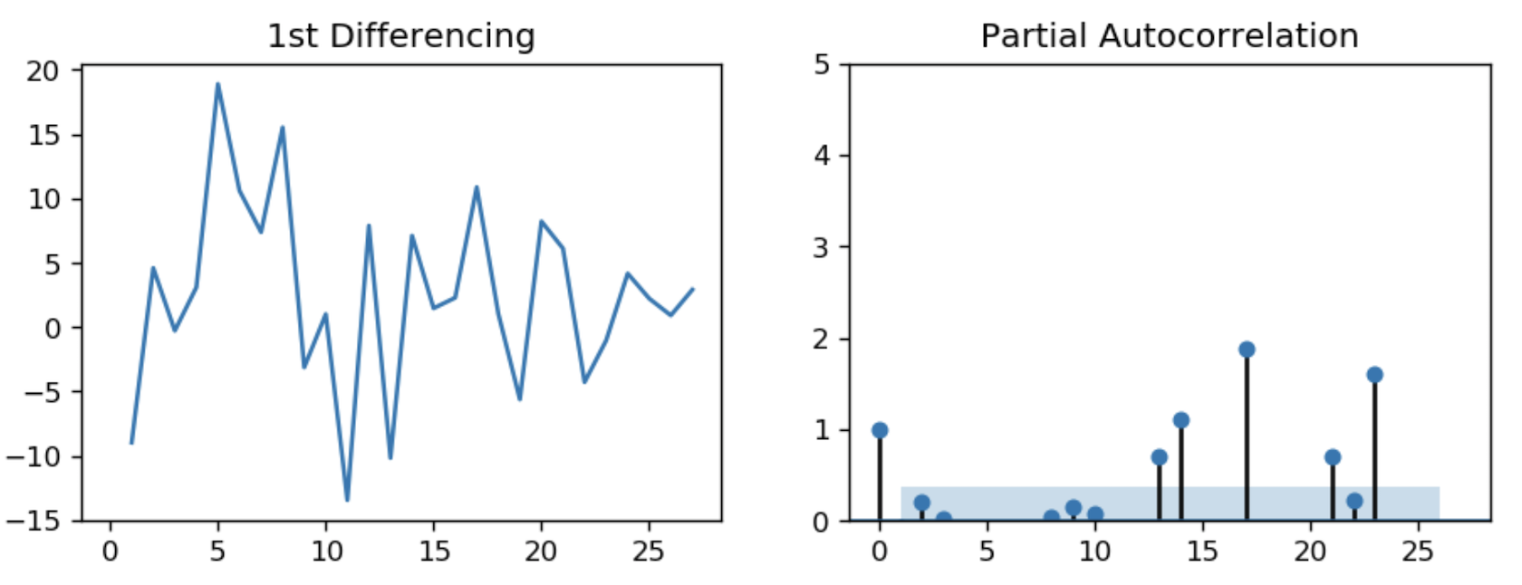
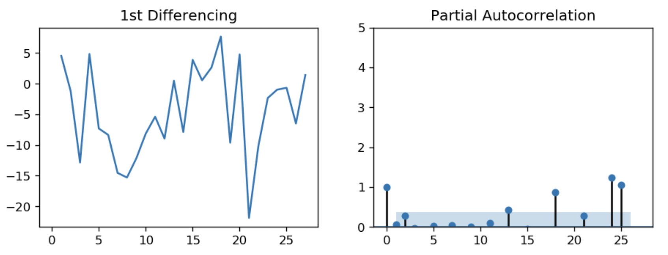
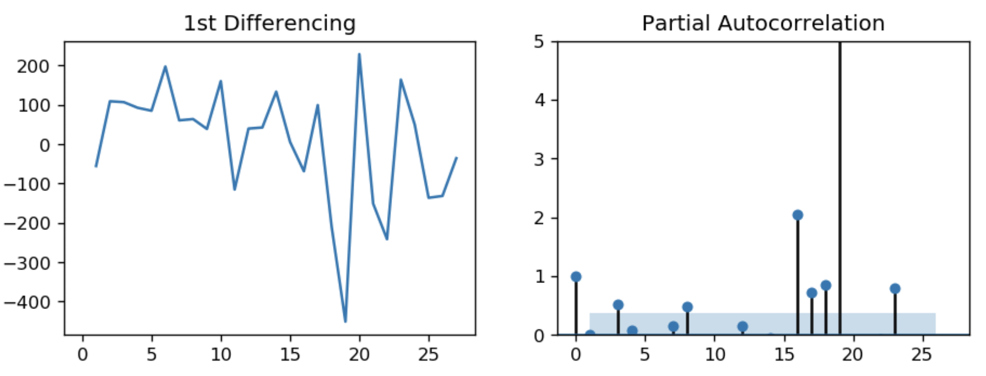
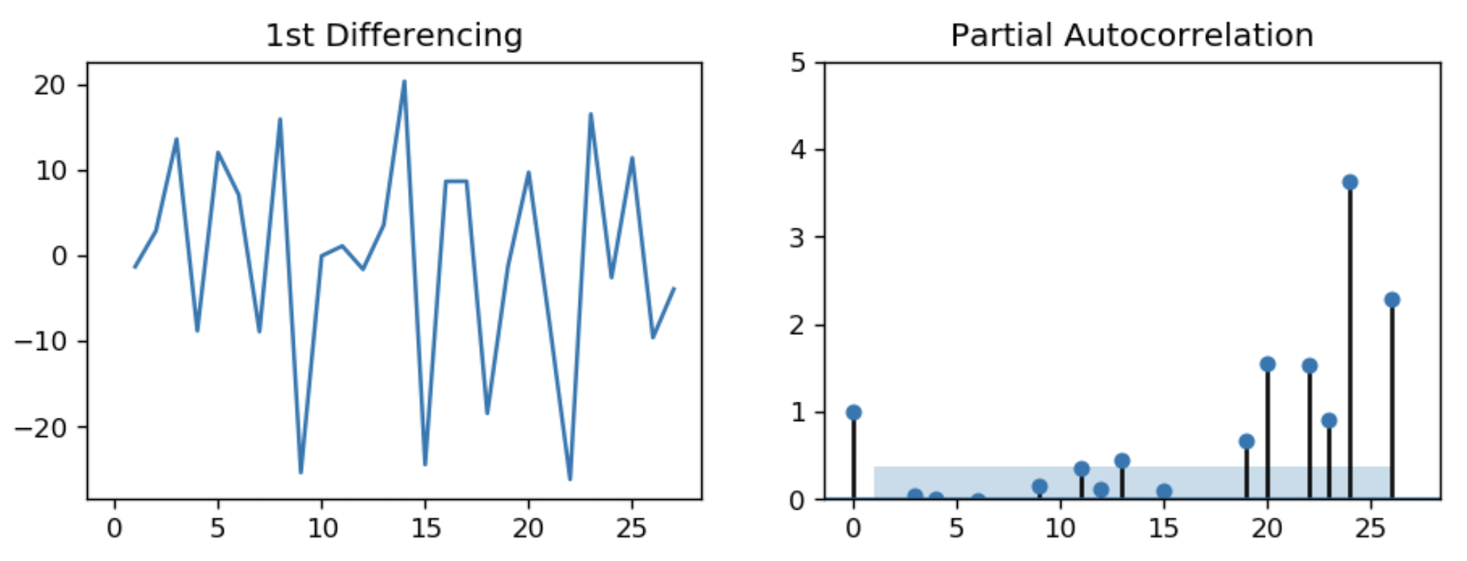
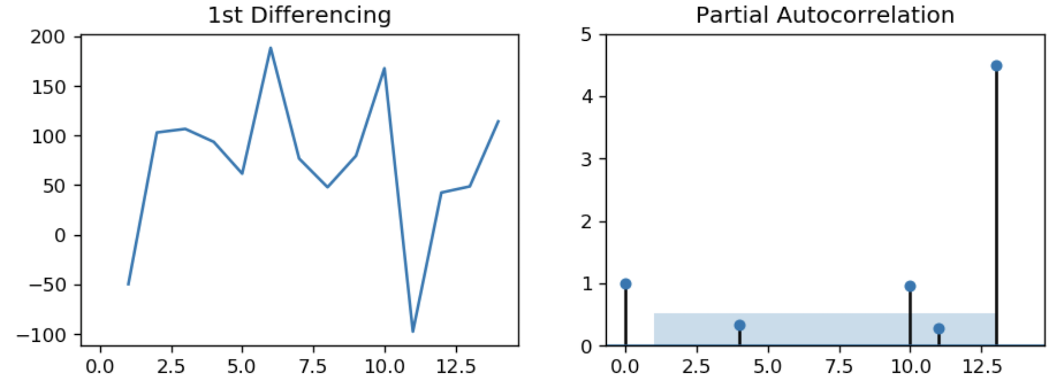
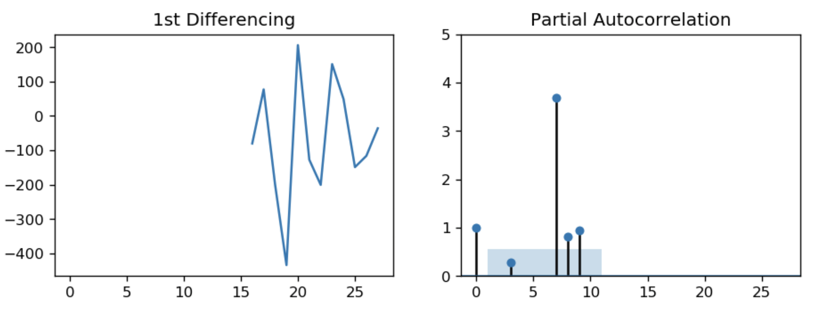
ARIMA – Find AR term (p) via Partial Autocorrelation (PACF)
Fluorinated Gases
Methane Oxide
TOTAL GASES
Nitrous Oxide
CO₂ Uptrend
CO₂ Downtrend
Notes:
Notice, the 2nd lag in all of the PACF plots are within the blue shaded significance zone, which means these are mostly an AR(0) process.

Slide 9
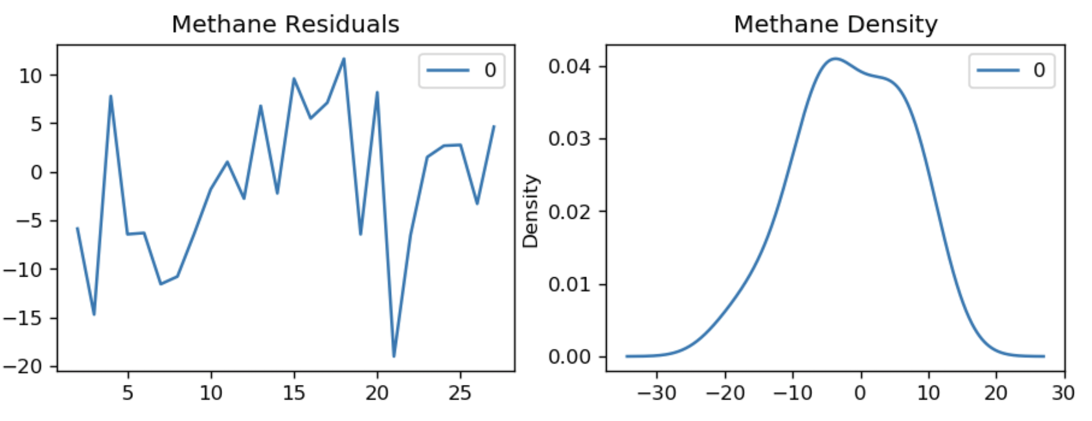
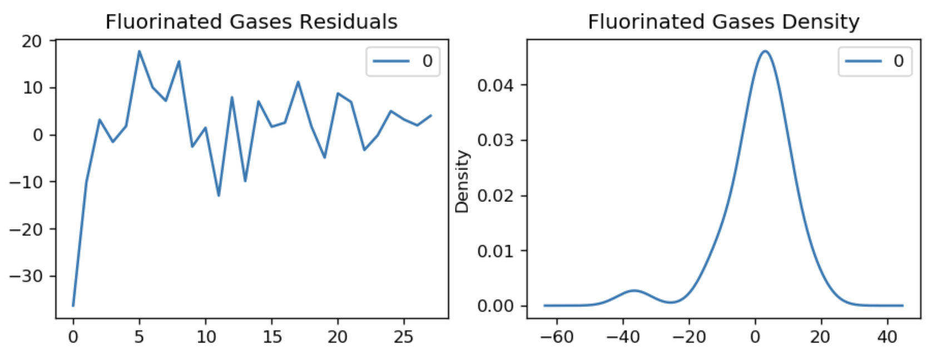
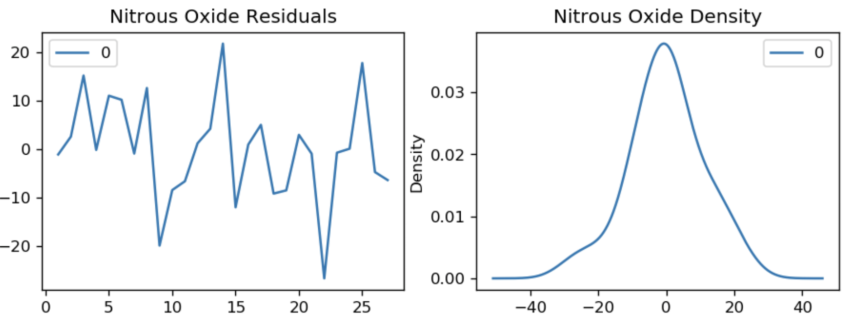
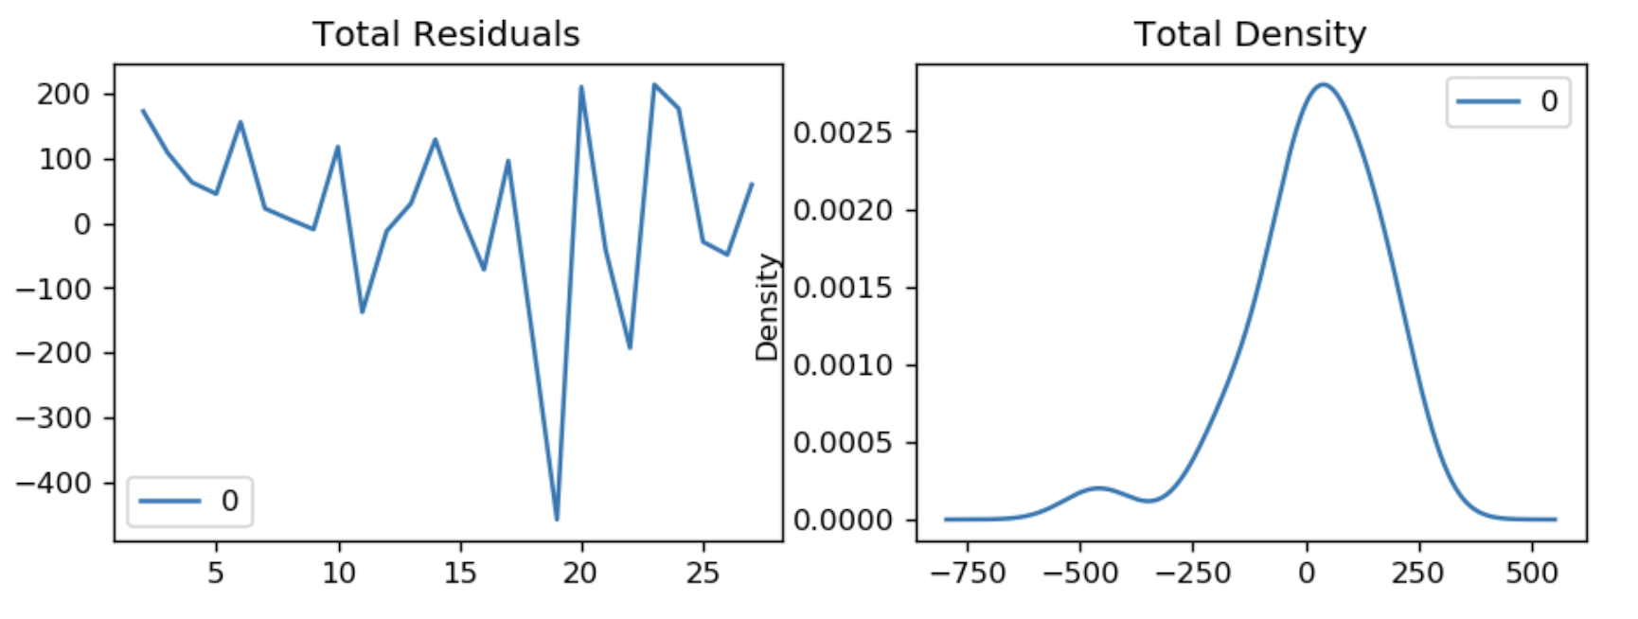
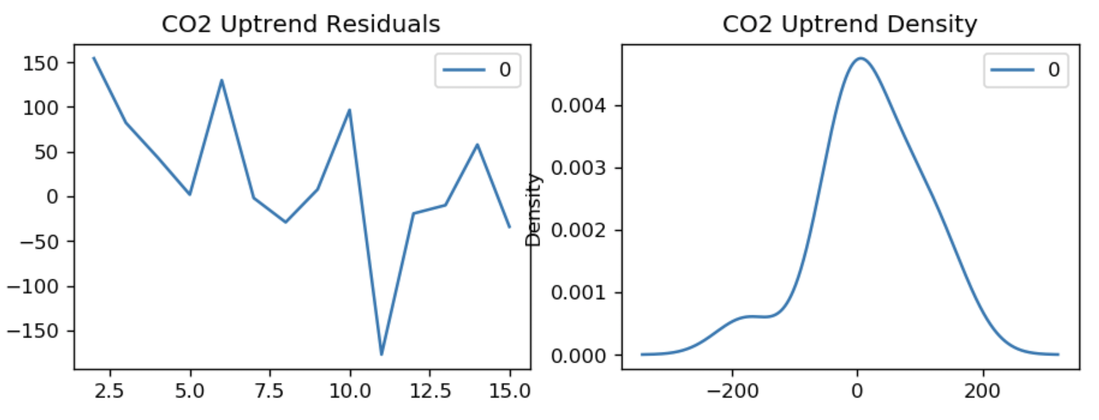
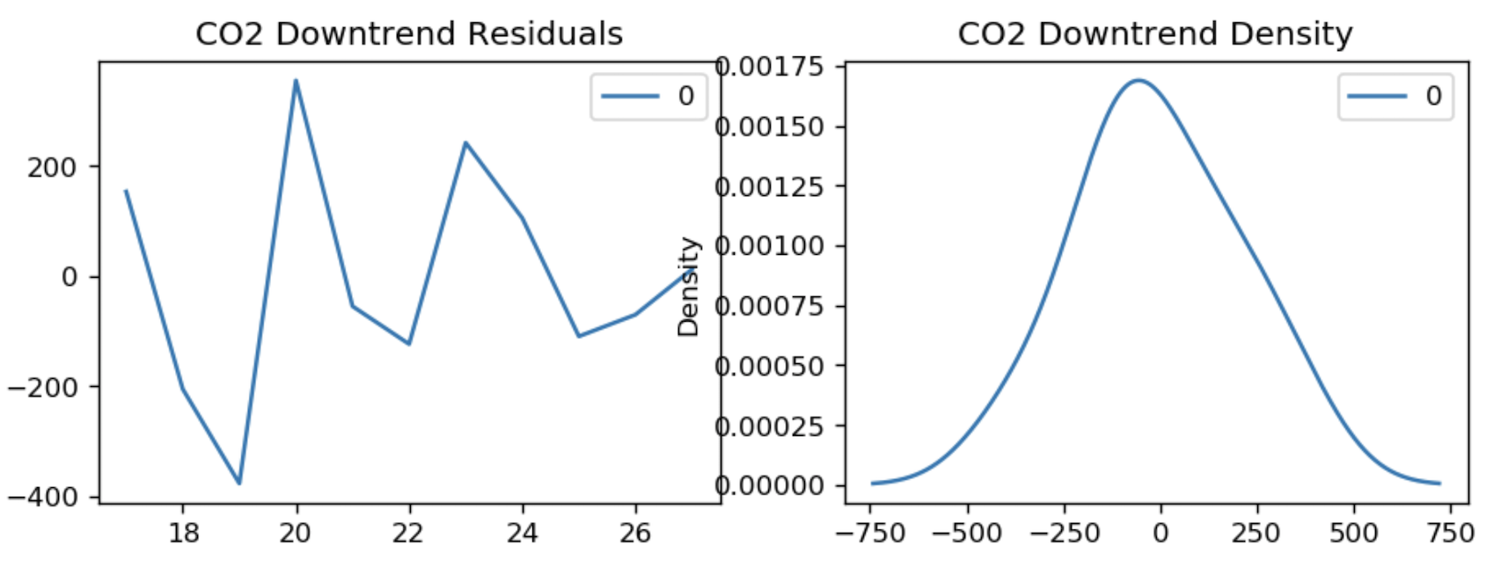
ARIMA – Residual Errors

Slide 10
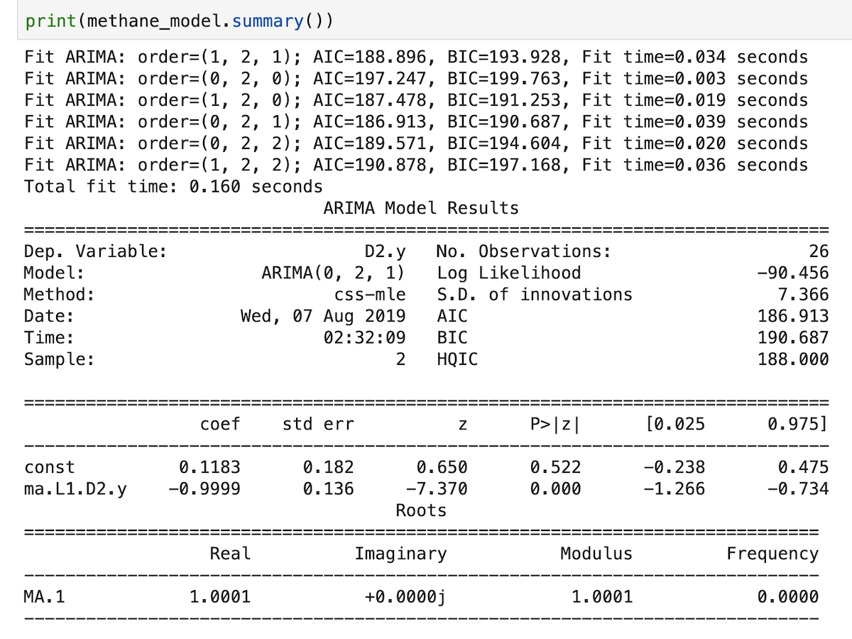
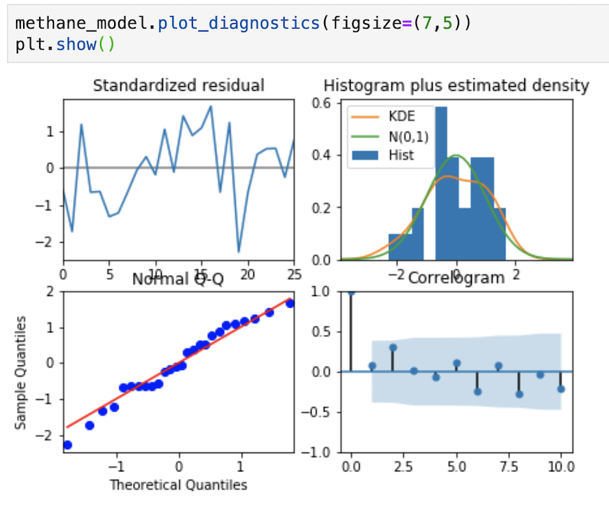
ARIMA – Model (Ex: methane)
Notes:
In the listed (sometimes infinite) ARIMA models, smallest AIC and BIC numbers are preferred.
Akaike Information Critera (AIC) and Bayesian Information Criteria (BIC) basically quantifies the goodness of fit and the model considered to be more likely to be the true model.

Slide 11
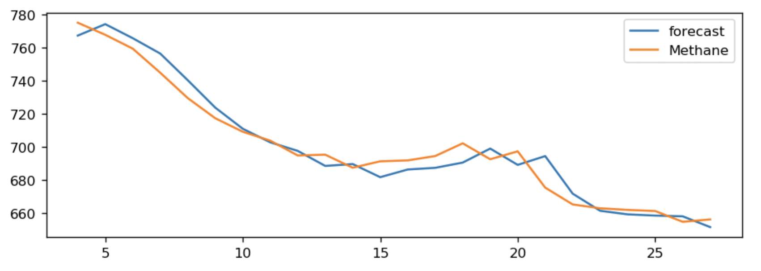
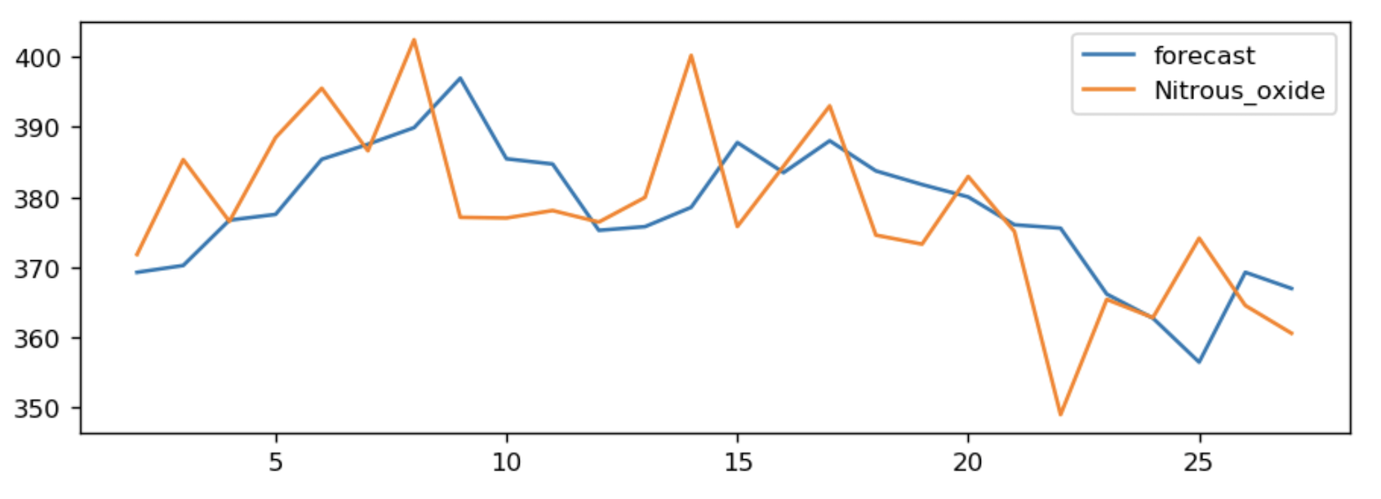
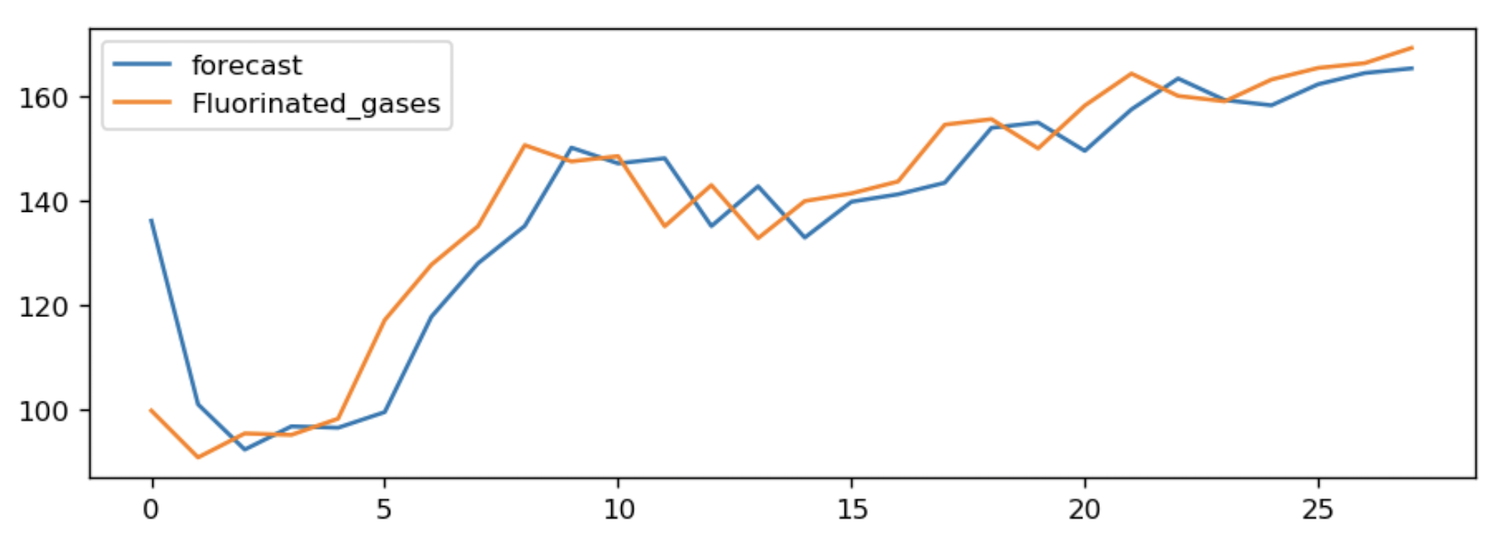
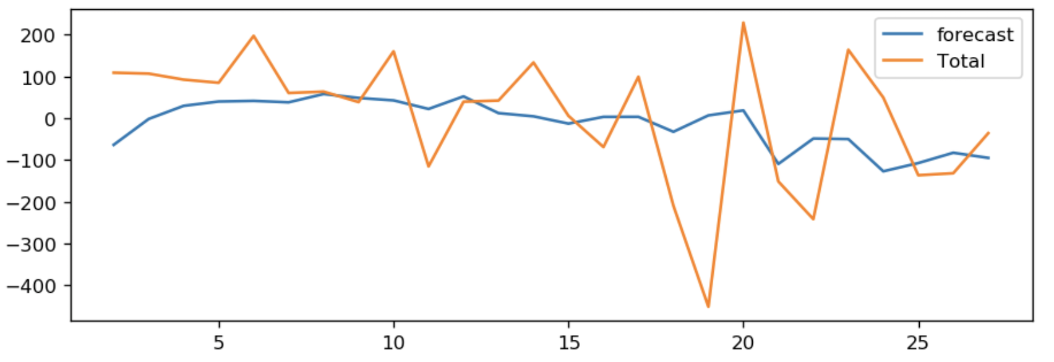
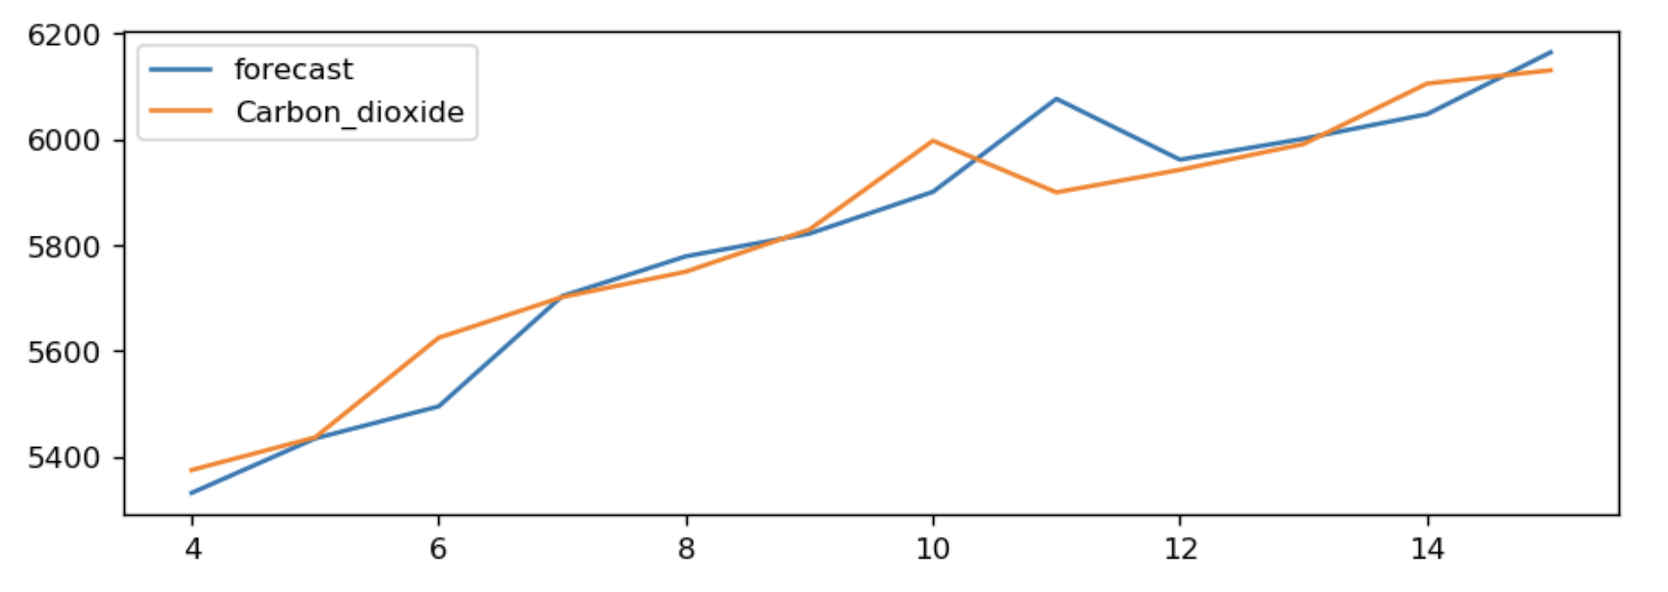
ARIMA – Actual vs. Fitted

Slide 12
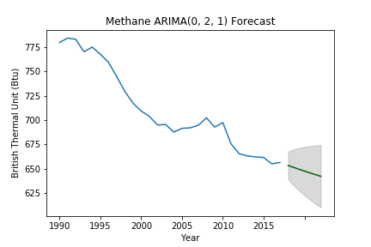
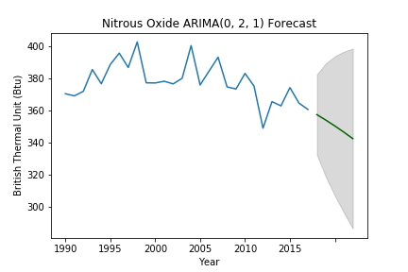
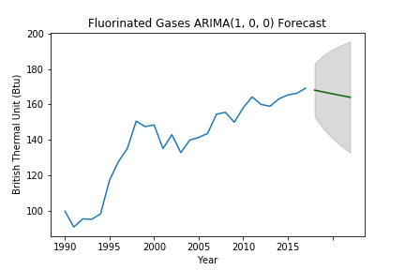
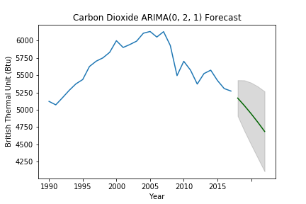
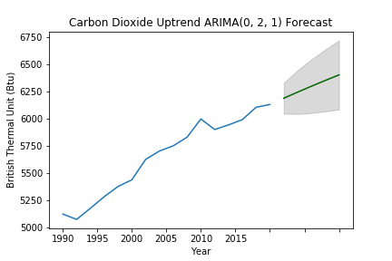
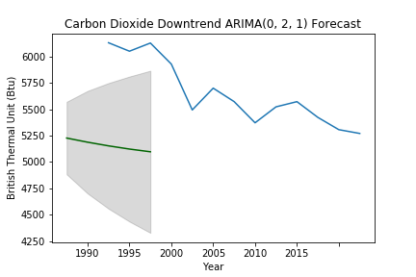
ARIMA Greenhouse Gas Emissions

Slide 13
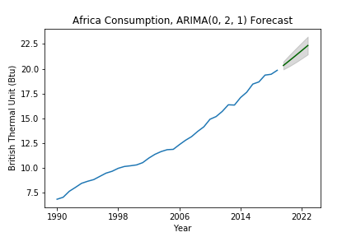
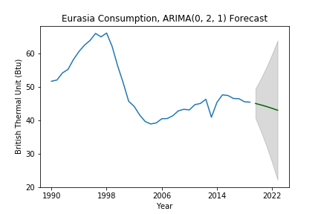
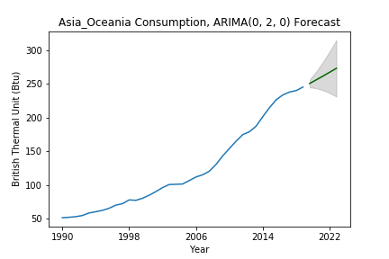
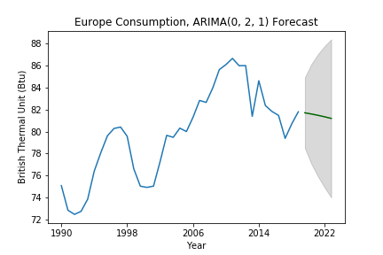
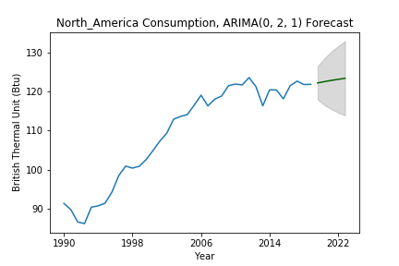
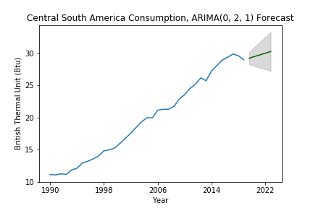
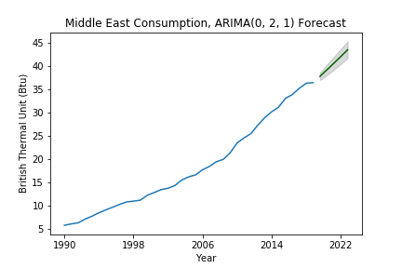
ARIMA Continental Energy Consumption

Slide 14







ARIMA Continental Energy Production

Slide 15







ARIMA Economic Sector Emissions

